Slide 1
Narrative Weaver
Design & Evaluative
Component
Group Loki | HCI | Section B
(Workplace Interactions & Wellbeing)
Presented By:
Adiba Habiba (0112230389)
Safrin Sanzida Islam (011212124)
Md. Noman Hossain(011222159)
Rownak Jahan (011183048)
Faria Benta Alamgir(0112230202)
Md. Mashrafe Hridoy(0112230197)

Slide 2
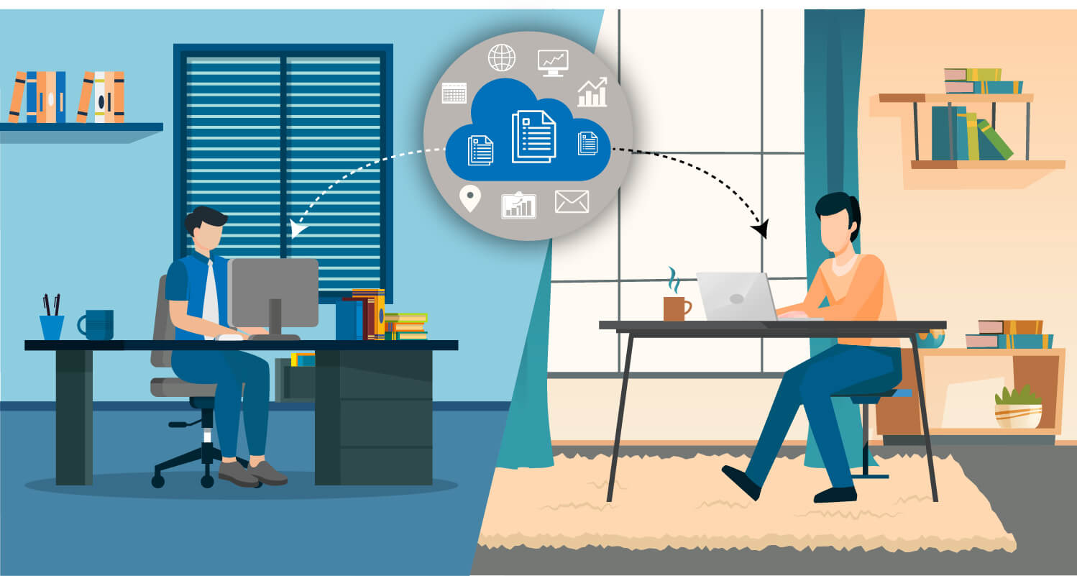
Workplace Wellbeing in Hybrid Work
💼 Work pressure, deadlines, and unclear requirements affect wellbeing
🧠 Employees often struggle to feel purpose in repetitive or fragmented work
🤖 AI tools create mixed feelings around trust, monitoring, and autonomy

Slide 3
Key Formative Takeaways
📋 Workload clarity matters more than motivation
🎯 Meaning comes from seeing impact
🔒 Users want control and transparency
⚖️ Trust in AI support is mixed

Slide 4


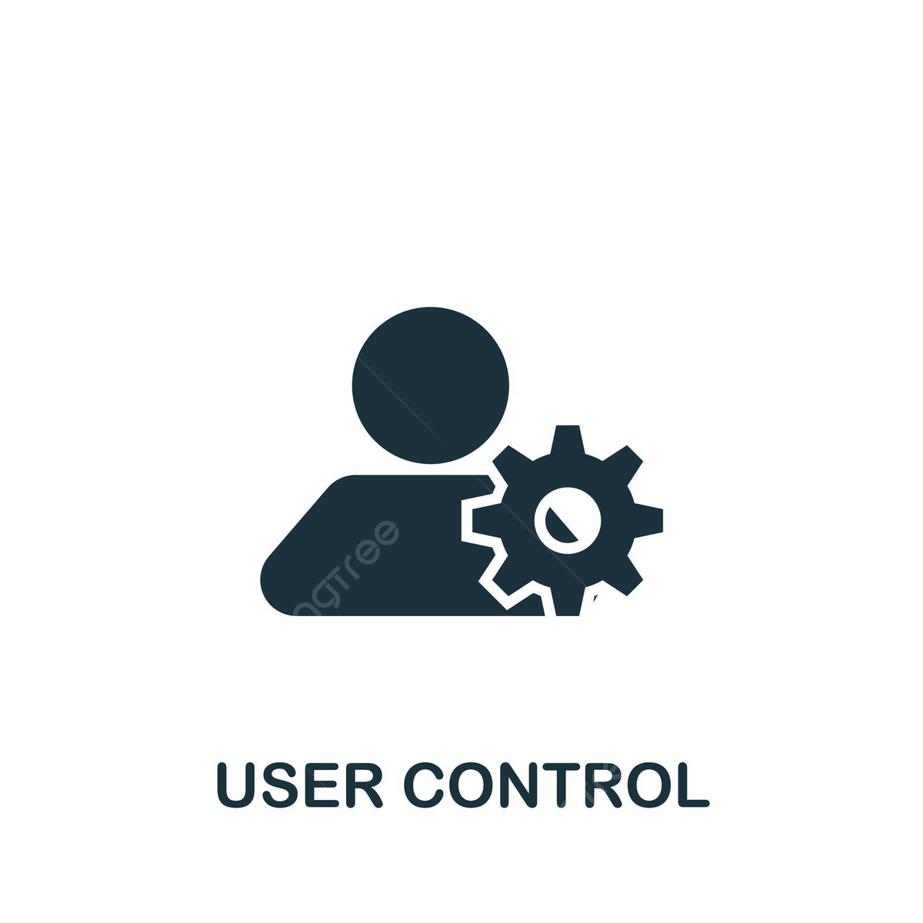

Design Goals
1
Support
reflection, not performance
2
Minimize interruption
3
Ensure user control
4
Avoid surveillance

Slide 5
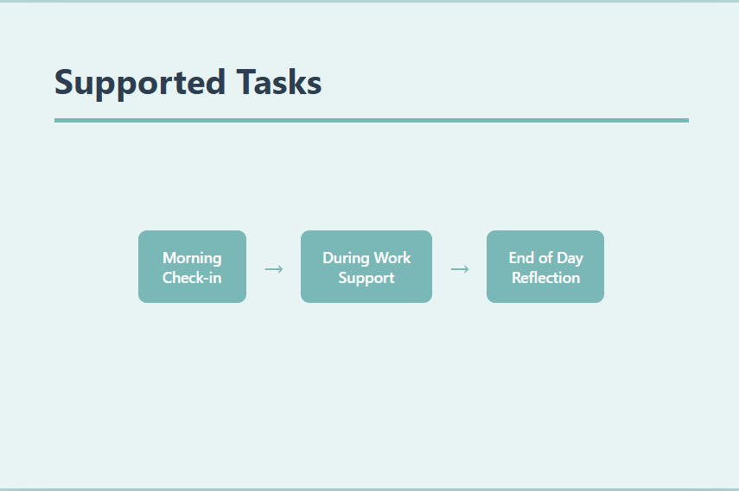

Slide 6
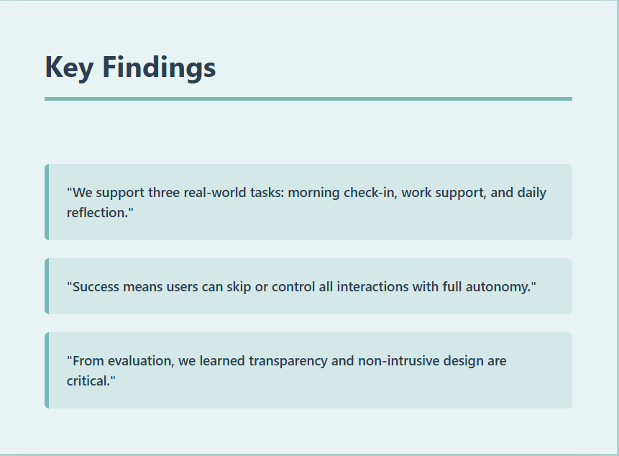

Slide 7
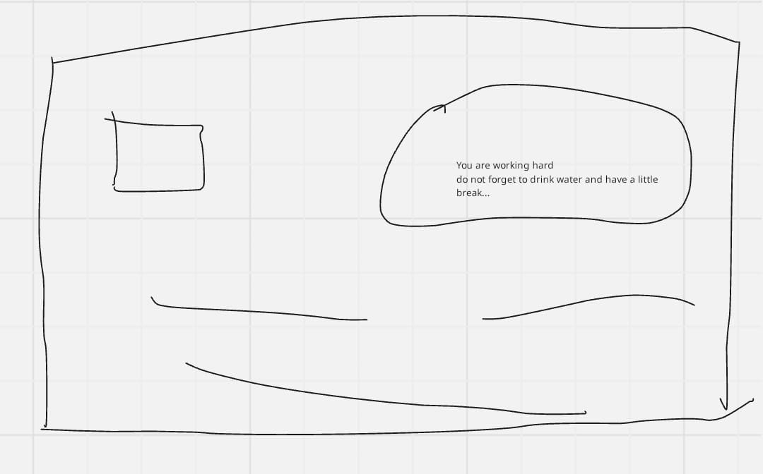
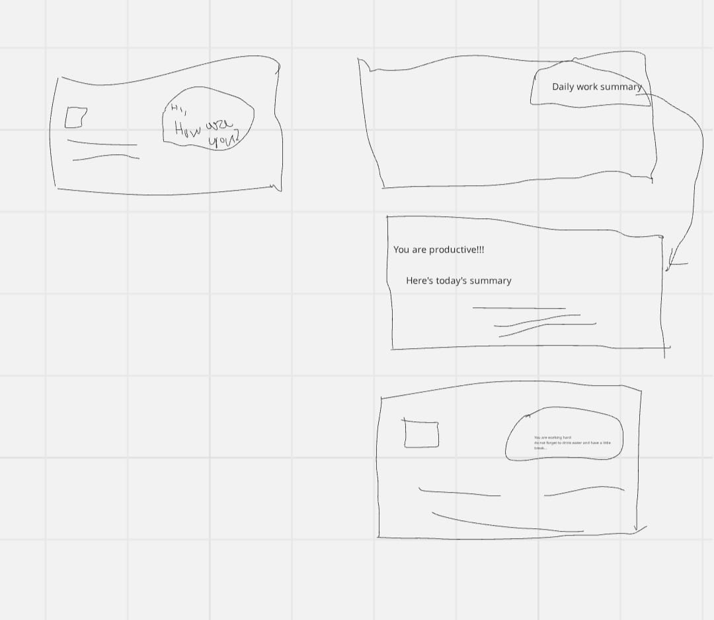
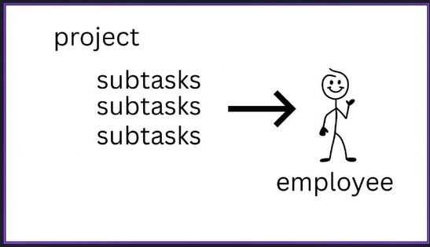
Participatory Designs

Slide 8
User-Driven Design Insights
People want AI that supports them, not watches them — something gentle that helps them pause, reflect, and feel okay at work.
Feeling seen makes people motivated — when employees can see their contribution and hear client feedback, their work feels more meaningful.
Wellbeing grows through human connection — real conversations and shared activities matter more than AI, which should only support, not replace, people.

Slide 9
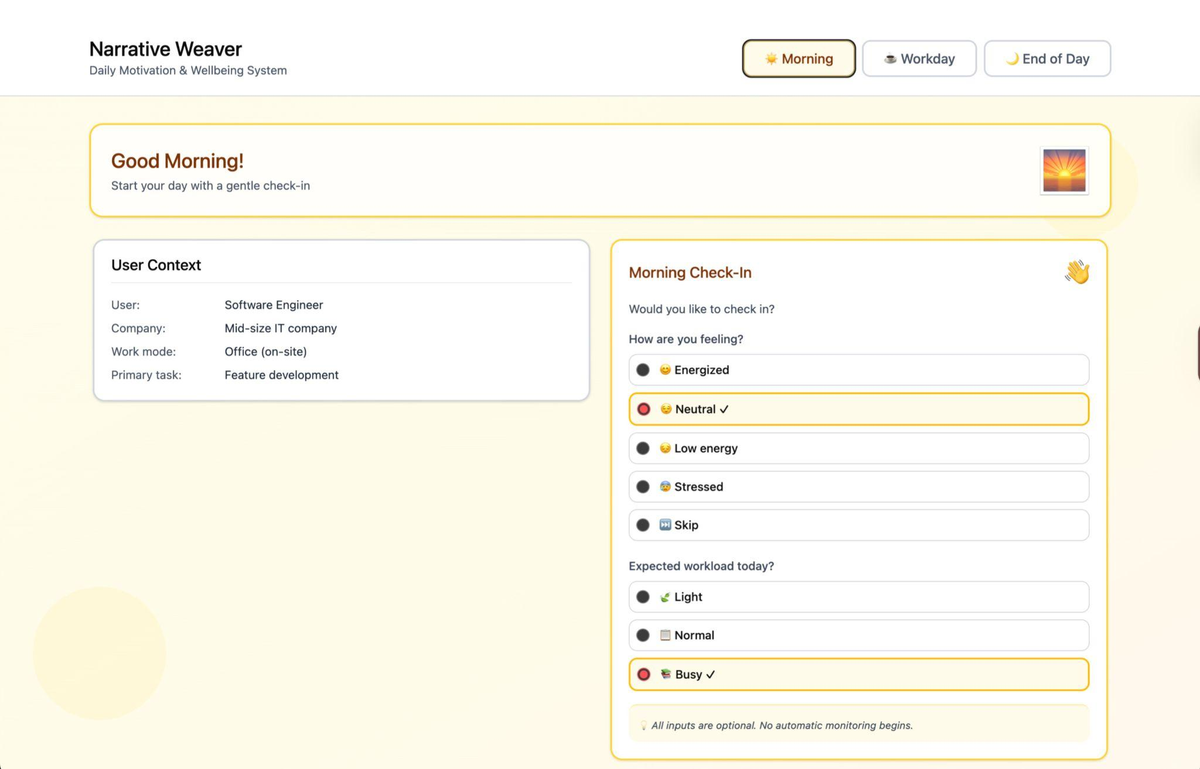
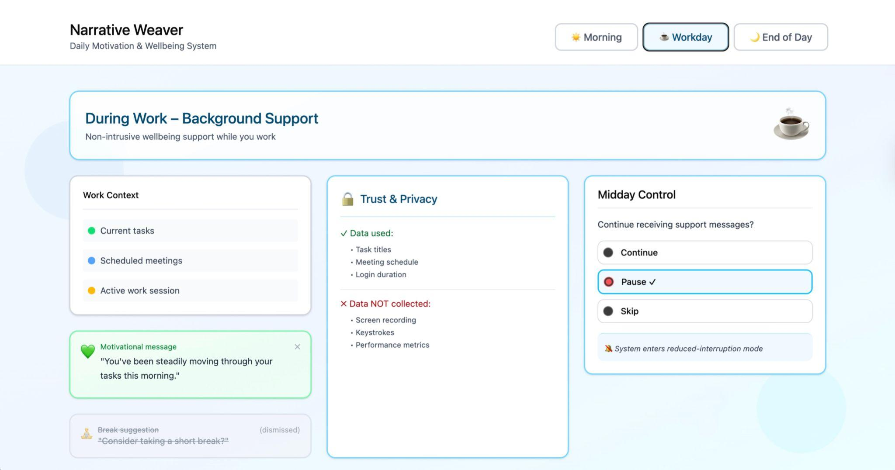
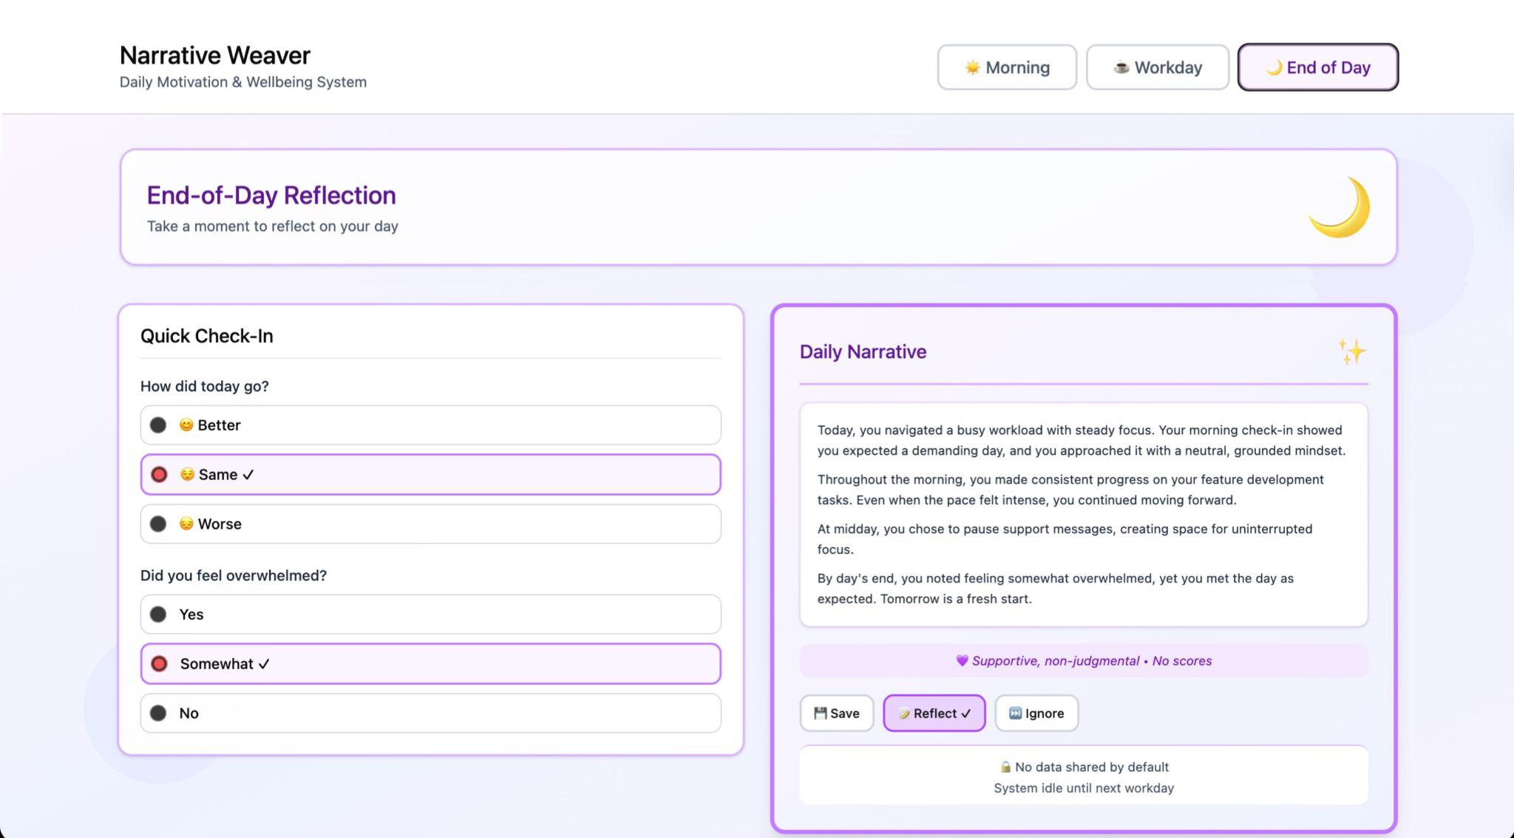
High-Fidelity Prototype

Slide 10
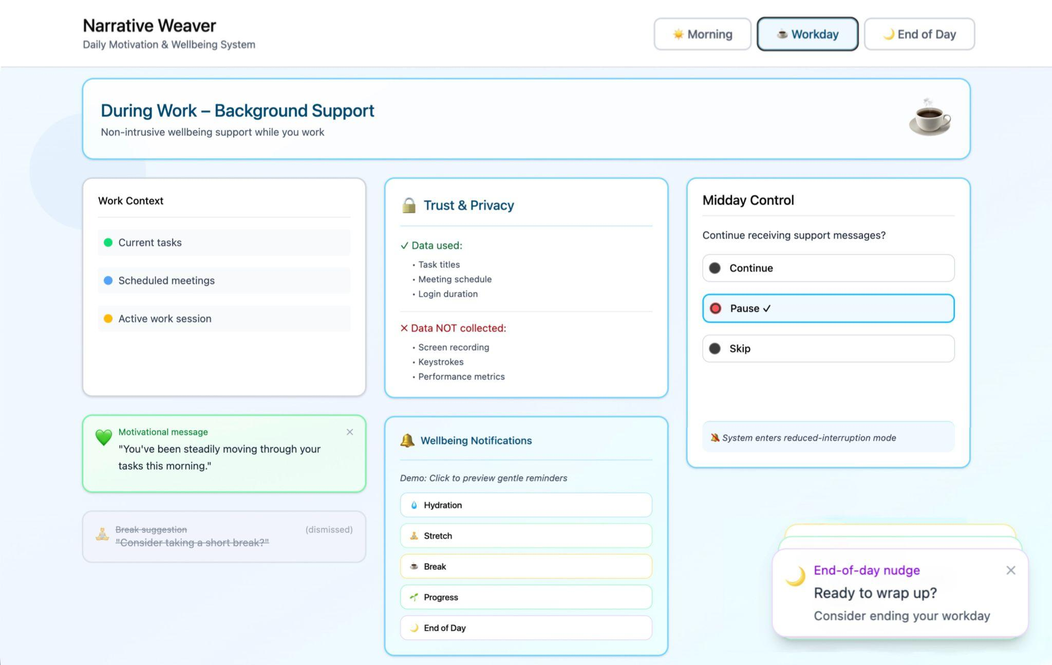
Design Changes After Feedback
Before After

Slide 11
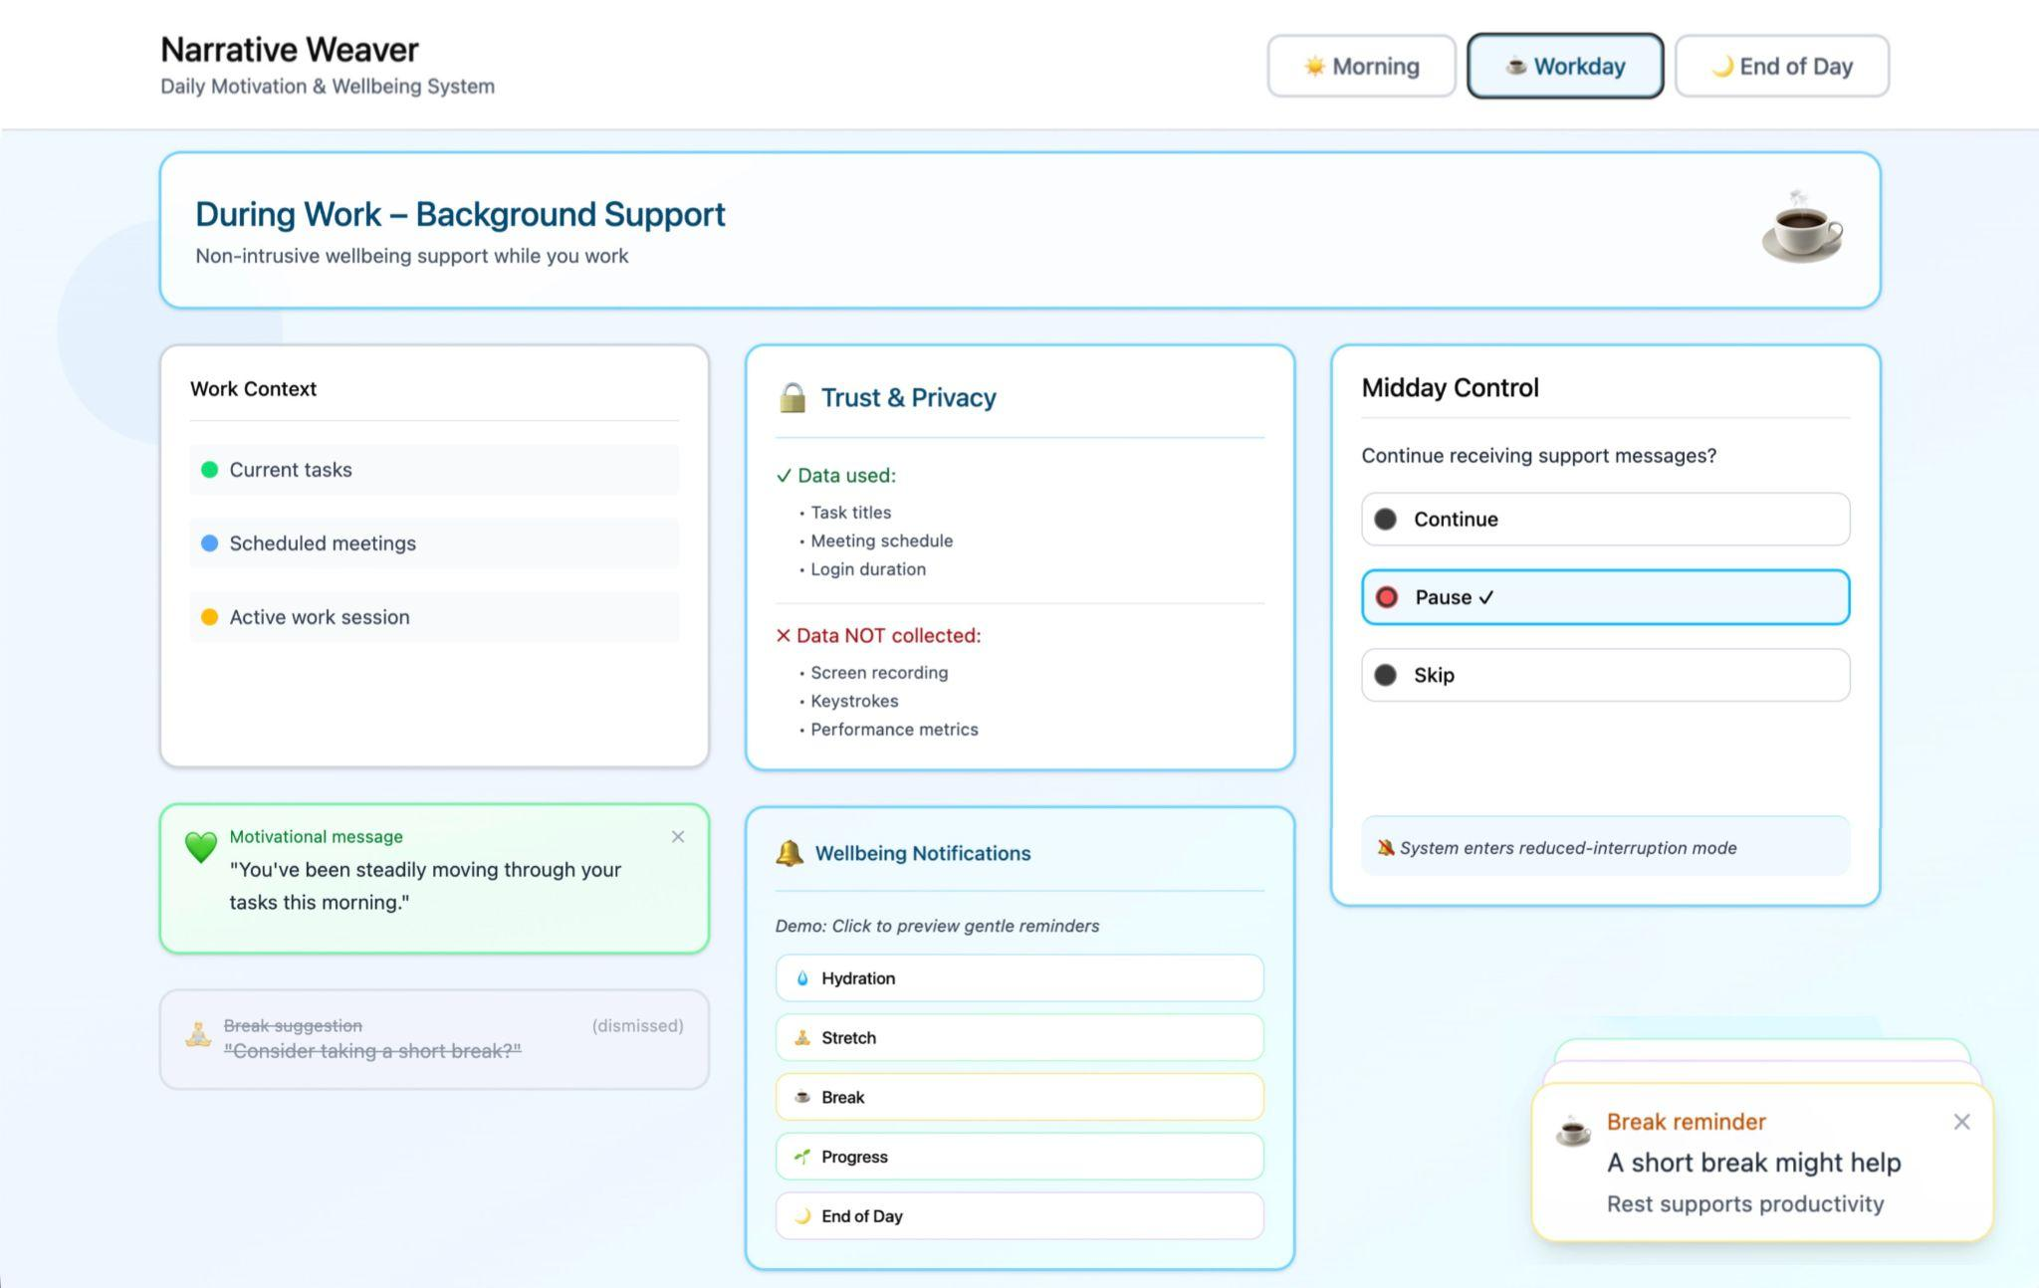
Changes Before Evaluation
Increased spacing in Midday Control for easier scanning
Added vertical breathing
room to Work Context card
Implemented compact pop-up notifications
Added brief clarifying text for notifications

Slide 12
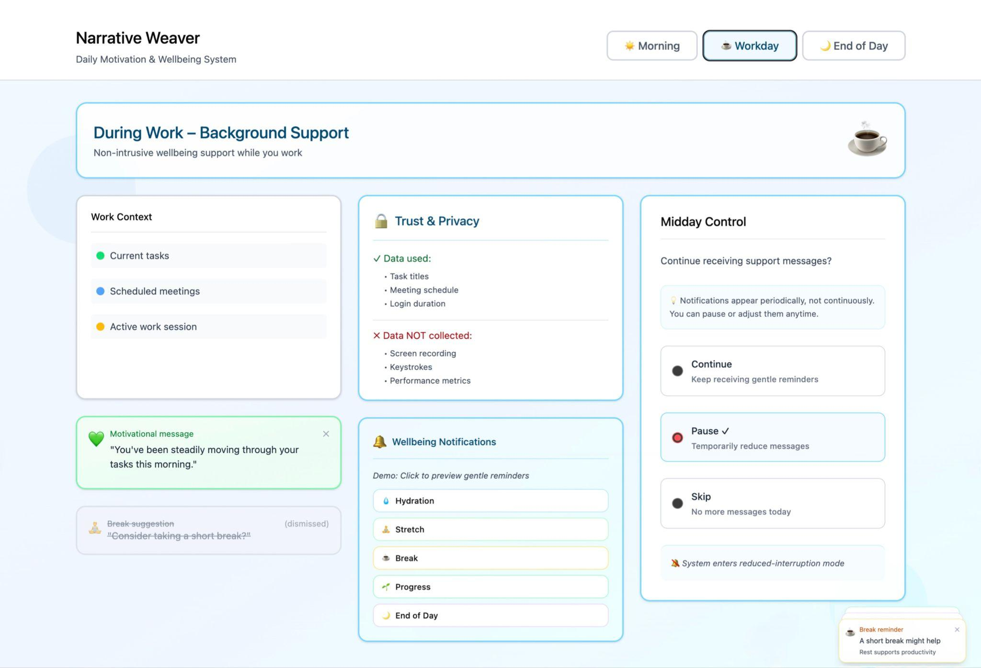
Changes After Evaluation
Midday Control (Continue / Pause )
Increased spacing between options
Easier to scan and calmer layout
Work Context Card
Added vertical space for breathing room
Less visual compression, clearer presentation
Notifications
Clarified timing: periodic, non-continuous, pausable
https://www.figma.com/make/OKx6ayWrwWqlChfWWZLSA4/Narrative-Weaver-Prototype-Design?p=f&fullscreen=1

Slide 13
Evaluation Method
Evaluation Goal
Evaluate whether Narrative Weaver supports user wellbeing
without being intrusive or stressful.
Evaluation Type
Formative User Experience Evaluation
Qualitative, user-centered approach
Evaluation Context
Interactive prototype
Individual use in workplace scenarios
Focus on experience over time

Slide 14
How We Evaluated
Methods Used
Scenario-based prototype testing
Short diary-based experience feedback
Post-use reflection interviews
What We Evaluate
Emotional comfort
Perceived supportiveness
User control and trust
Meaningfulness of AI narratives

Slide 15
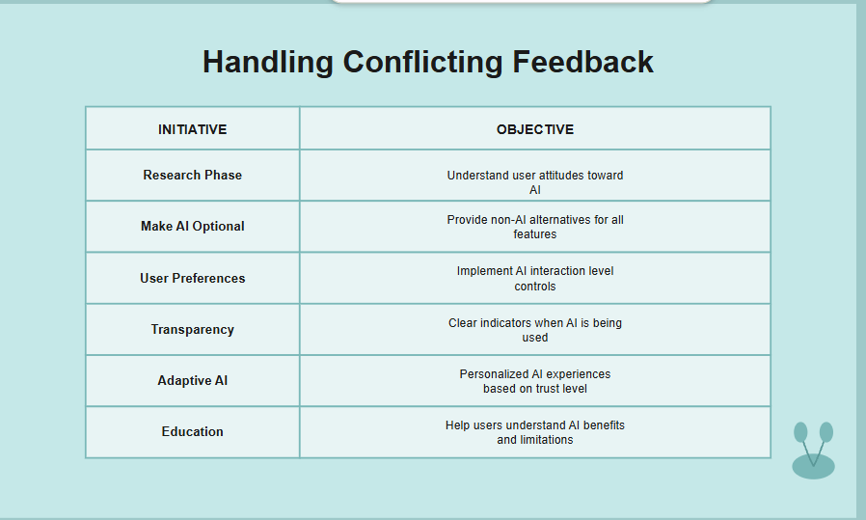
Handling Conflicting Feedback
INITIATIVE | OBJECTIVE | JAN | FEB | MAR | APR | MAY | JUN | JUL | AUG | SEP | OCT | NOV | DEC
Research Phase | Understand user attitudes toward AI
Make AI Optional | Provide non-AI alternatives for all features
User Preferences | Implement AI interaction level controls
Transparency | Clear indicators when AI is being used
Adaptive AI | Personalized AI experiences based on trust level
Education | Help users understand AI benefits and limitations

Slide 16
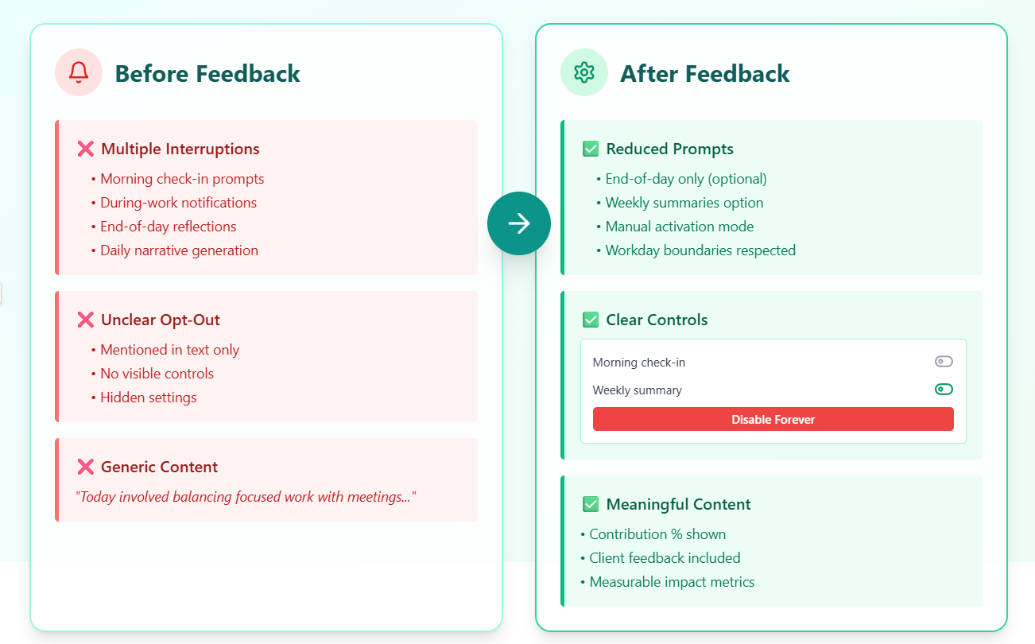

Slide 17
Team Responsibilities
Adiba Habiba | Coordination & Reporting
Md. Noman Hossain | Md High-Fidelity Prototype
Rownak Jahan | Paper Prototyping & Feedback
Fariha Benta Alamgir | Task Definition & Findings
Md. Mashrafe Hridoy | Insight Interpretation
Safrin Sanzida Islam | Evaluation Method

Slide 18
Conclusion
This project demonstrates a complete HCI process from formative research to design and evaluation.

Slide 19
THANKS!
Does anyone have any questions?
addyouremail@freepik.com
+91 620 421 838
yourcompany.com
Please keep this slide for attribution

Slide 20
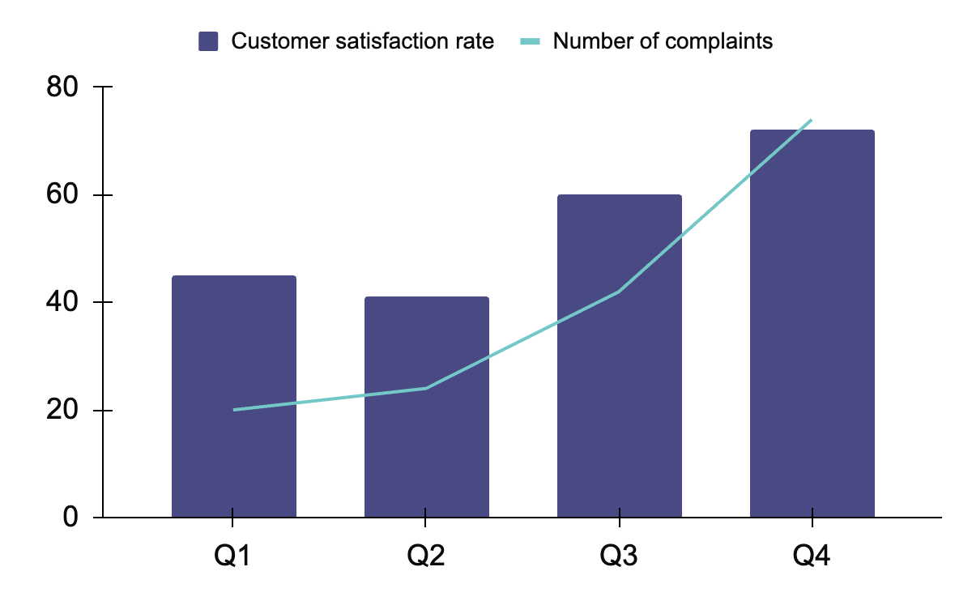
KPI DASHBOARD
RESOURCE | UTILIZATION RATE | COST PER UNIT
LABOR | 85% | $50
EQUIPMENT | 70% | $100
MATERIALS | 95% | $20
RENT | 90% | $1,000
ENERGY | 80% | $80
LICENSES | 80% | $200
ADVERTISING | 60% | $500
120 U/DAY
2H
Output per worker
Time to complete a task
Follow the link in the graph to modify its data and then paste the new one here. For more info, click here

Slide 21
ICON PACK

Slide 22
ALTERNATIVE RESOURCES
Here’s an assortment of alternative resources whose style fits the one of this template:
Hand drawn gathering data in business

Slide 23
Instructions for use
If you have a free account, in order to use this template, you must credit Slidesgo by keeping the Thanks slide. Please refer to the next slide to read the instructions for premium users.
As a Free user, you are allowed to:
Modify this template.
Use it for both personal and commercial projects.
You are not allowed to:
Sublicense, sell or rent any of Slidesgo Content (or a modified version of Slidesgo Content).
Distribute Slidesgo Content unless it has been expressly authorized by Slidesgo.
Include Slidesgo Content in an online or offline database or file.
Offer Slidesgo templates (or modified versions of Slidesgo templates) for download.
Acquire the copyright of Slidesgo Content.
For more information about editing slides, please read our FAQs or visit our blog:
https://slidesgo.com/faqs and https://slidesgo.com/slidesgo-school

Slide 24
Instructions for use (premium users)
As a Premium user, you can use this template without attributing Slidesgo or keeping the "Thanks" slide.
You are allowed to:
Modify this template.
Use it for both personal and commercial purposes.
Hide or delete the “Thanks” slide and the mention to Slidesgo in the credits.
Share this template in an editable format with people who are not part of your team.
You are not allowed to:
Sublicense, sell or rent this Slidesgo Template (or a modified version of this Slidesgo Template).
Distribute this Slidesgo Template (or a modified version of this Slidesgo Template) or include it in a database or in any other product or service that offers downloadable images, icons or presentations that may be subject to distribution or resale.
Use any of the elements that are part of this Slidesgo Template in an isolated and separated way from this Template.
Register any of the elements that are part of this template as a trademark or logo, or register it as a work in an intellectual property registry or similar.
For more information about editing slides, please read our FAQs or visit our blog:
https://slidesgo.com/faqs and https://slidesgo.com/slidesgo-school

Slide 25
Fonts & colors used
This presentation has been made using the following fonts:
Albert Sans
(https://fonts.google.com/specimen/Albert+Sans)
Outfit
(https://fonts.google.com/specimen/Outfit)
#494983
#0a0a0a
#d1eeee
#b4dddd
#e9eec6
#4d585c
#ffffff
#73c7c7
#6767ac
#c5e7e7

Slide 26





Storyset
Create your Story with our illustrated concepts. Choose the style you like the most, edit its colors, pick the background and layers you want to show and bring them to life with the animator panel! It will boost your presentation. Check out how it works.
Pana
Amico
Bro
Rafiki
Cuate

Slide 27
Use our editable graphic resources...
You can easily resize these resources without losing quality. To change the color, just ungroup the resource and click on the object you want to change. Then, click on the paint bucket and select the color you want. Group the resource again when you’re done. You can also look for more infographics on Slidesgo.

Slide 30
JANUARY
FEBRUARY
MARCH
APRIL
MAY
JUNE
PHASE 1
Task 1
Task 2
PHASE 2
Task 1
Task 2
JANUARY
FEBRUARY
MARCH
APRIL
PHASE 1
Task 1
Task 2

Slide 33
...and our sets of editable icons
You can resize these icons without losing quality.
You can change the stroke and fill color; just select the icon and click on the paint bucket/pen.
In Google Slides, you can also use Flaticon’s extension, allowing you to customize and add even more icons.

Slide 34
Educational Icons
Medical Icons

Slide 35
Business Icons
Teamwork Icons

Slide 36
Help & Support Icons
Avatar Icons

Slide 37
Creative Process Icons
Performing Arts Icons

Slide 38
Nature Icons

Slide 39
SEO & Marketing Icons

Slide 40


